Slide 2

Oracle Maximum Availability Architecture Best Practices for Oracle Exadata
Joseph Meeks, Director
High Availability Product Management, Oracle
Michael Smith, Consulting Member of Technical Staff
MAA Development, Oracle
Rahul Pednekar, VP, Senior Oracle DBA
Technology Infrastructure, Bank Of America Merrill Lynch

Slide 3
Program Agenda
Exadata and Oracle Maximum Availability Architecture
High Availability Out of the Box
Oracle MAA Configuration Best Practices
Reference Configurations
Bank of America

Slide 4
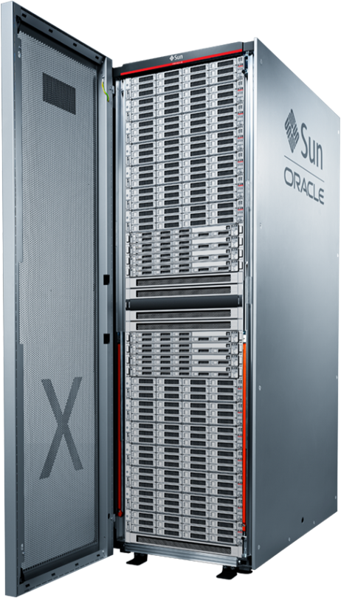
Oracle Exadata Database Machine
An Engineered System: Compute, Storage, Networking
Database Cluster
Intel-based database servers
Oracle Linux or Solaris 11
Oracle Database 11g
10 Gig Ethernet (to data center)
Storage Grid
Intel-based storage servers
Up to 504 terabytes raw disk
5.3 terabytes Flash storage
Exadata Storage Server Software
InfiniBand Network
Internal connectivity ( 40 Gb/sec )

Slide 5
Exadata Built-In Hardware Redundancy
Redundant Database Servers
Active-Active highly available clustered servers
Hot-swappable power supplies and fans
Redundant power distribution units
Redundant Storage Grid
Data mirrored across storage servers
Redundant, non-blocking IO paths
Redundant Network
Redundant 40GB/s IB connections and switches
Client access using HA bonded networks
Notes:
Clustered database servers (RAC)
Data mirrored across storage servers (ASM)
Redundant non-blocking IO paths from servers to storage with 40Gb/s IB connections and switches
Servers have hot-swappable power supplies and fans
Each Exadata rack has redundant power distribution units
Client access can be configured with HA bonded networks

Slide 6


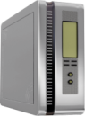






Maximum Availability Architecture (MAA)
Integrated, Active, High Return on Investment
Production Site
Active Replica
RAC
Scalability
Server HA
Active Data Guard
Data Protection, DR
Query Offload
GoldenGate
Active-active
Heterogeneous
Migrations and Upgrades
Flashback
Human error correction
ASM
Volume Management
Online Redefinition, Edition-based Redefinition, Data Guard, GoldenGate
Minimal downtime maintenance, upgrades, and migrations
RMAN & Fast Recovery Area
On-disk backups
Oracle Secure Backup
Backup to tape / cloud

Slide 7
Building Blocks of MAA
Architecture and Best Practices
MAA
Architecture
This Presentation
Configuration Best Practices
CON8392: Operational Best Practices For Oracle Exadata
Wednesday, 10:15am, Room 102 Moscone South
Operational Best Practices
Notes:
Here’s the 3 pillars to reach MAA. With Exadata, each pillar has been optimized for MAA and simpler to deploy.

Slide 8

High Availability Out of the Box

Slide 9
Configuration
Oracle OneCommand
Automate installation and configuration
Uses Exadata/MAA best practices for:
Grid Infrastructure, Oracle Storage Grid and Oracle Database
Operating system (Linux or Solaris X86)
Network configuration (client and admin access, GigE, InfiniBand)
Initial monitoring setup (SNMP alerts, Oracle Configuration Manager, Automatic Service Request, Grid Control Agents)
DBCA template for future usage
Within days of arrival, the Exadata System and Oracle Database are ready for use

Slide 10
Storage
Preconfigured Protection
Read and repair corruption from mirror with no application impact
Most mirroring solutions will read from mirror copy of block on I/O error or failed storage checksum
Exadata does this plus performs additional validation and will also read from mirror if a block is internally corrupt
Highly available storage grid configured out of the box
Creating disk group automatically creates associated failure groups
Disk group attributes preconfigured to give optimal uptime
Disk group placement on disk for optimal scalability

Slide 11
InfiniBand Network
Preconfigured Low Brownout and High Bandwidth
Network configuration
Exhaustive testing has reduced brownout during InfiniBand failures
BONDING_OPTS="mode=active-backup miimon=100 downdelay=5000 updelay=5000 num_grat_arp=100“
Switch and port failures are handled efficiently and transparently

Slide 12
Compute Nodes
Preconfigured High Availability
DBCA templates with HA best practices built in
Intelligent file redundancy configurations (ex: control file mirroring)
Parameter settings based on best practices
SGA / PGA configuration
Performance optimizations that also prevent outages
Efficient memory management using hugepages
Notes:
Note that Hugepages is preconfigured for a single database. It will need to be modified to optimize for consolidated environments that support multiple databases on a single Exadata system.

Slide 13
Automated Exadata Health Check
Exachk
Comprehensive configuration check of Exadata software and hardware
Reports any variance from MAA best practices
Detects problems before they impact production
Run monthly
Run pre/post maintenance
Download My Oracle Support Note 1070954.1

Slide 14
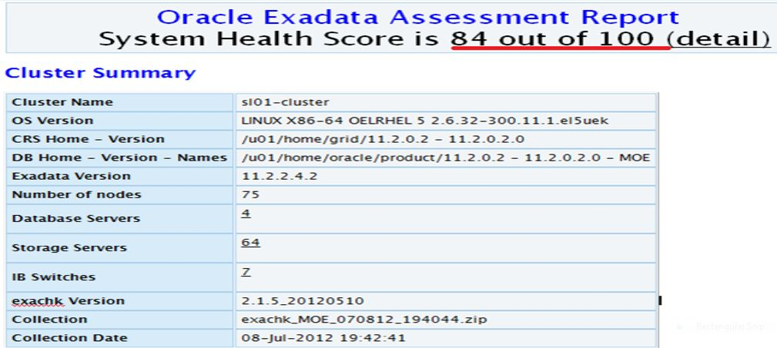
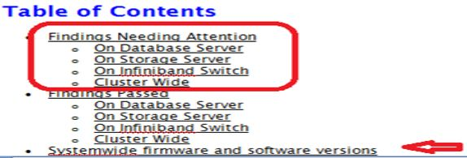
Exachk Report

Slide 15
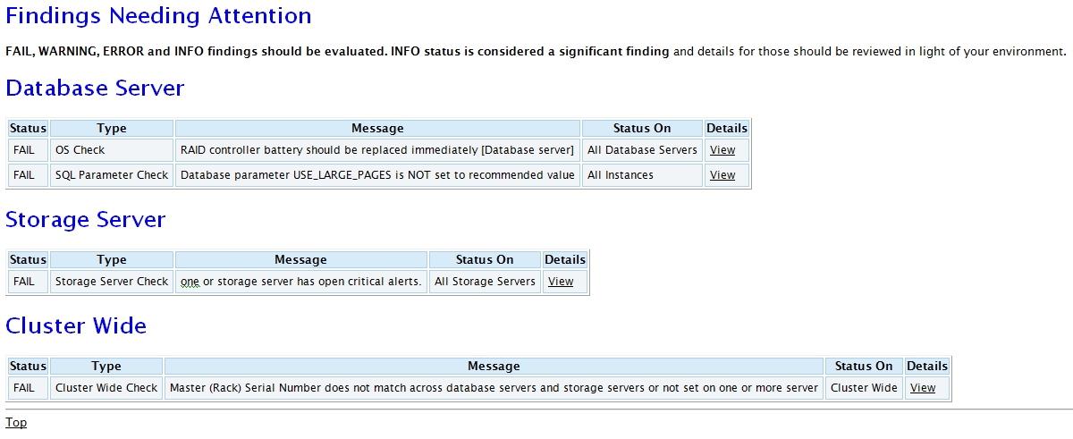
Exachk Sample Output

Slide 16
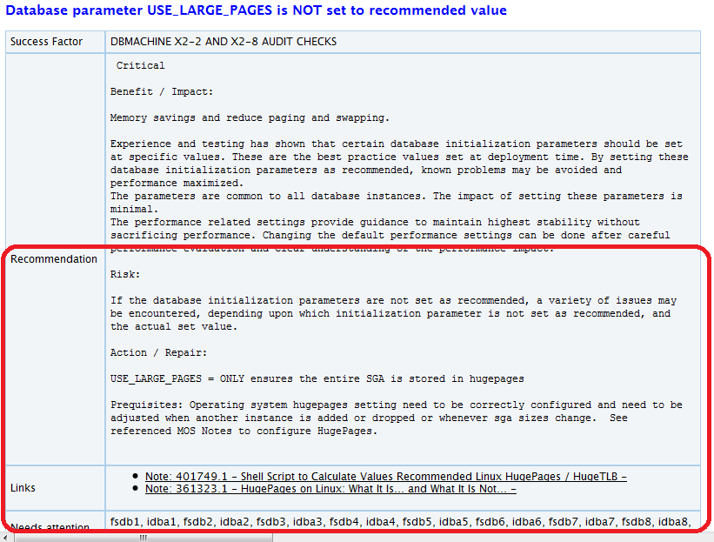
Recommendation and Repair
Notes:
Hugepages is a recommendation. Reduce page table memory footprint which could be 15-20 GBs in some cases. Avoid paging/swapping.

Slide 17

Oracle MAA Configuration Best Practices

Slide 18
Essential Exadata Operational Practices
Goal: Maximum Stability and Availability
Configuration Best Practices
Disaster Recovery
Storage
Network
Compute
Corruption
Backup

Slide 19
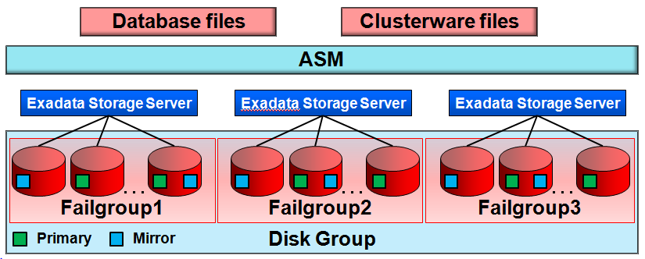
MAA for Storage Servers
Automatic Storage Management (ASM)
Single ASM storage grid, three disk groups
DATA, data files
RECO, recovery files
DBFS, file system data
ASM redundancy protects against disk failure
Failure groups eliminate single point of failure
Intelligent corruption handling and automatic repair
ASM high redundancy (triple mirroring) for best data protection
Alternative of using ASM normal redundancy (double mirroring) if also using Data Guard
Notes:
Oracle ASM is a volume manager and a file system for Oracle database files that supports single-instance Oracle Database and Oracle Real Application Clusters (Oracle RAC) configurations. Oracle ASM is Oracle's recommended storage management solution that provides an alternative to conventional volume managers, file systems, and raw devices.
Oracle ASM uses disk groups to store data files; an Oracle ASM disk group is a collection of disks that Oracle ASM manages as a unit. Within a disk group, Oracle ASM exposes a file system interface for Oracle database files. The content of files that are stored in a disk group is evenly distributed to eliminate hot spots and to provide uniform performance across the disks. The performance is comparable to the performance of raw devices.
You can add or remove disks from a disk group while a database continues to access files from the disk group. When you add or remove disks from a disk group, Oracle ASM automatically redistributes (rebalances the ASM extents across the available disks) the file contents and eliminates the need for downtime when redistributing the content. For information about administering disk groups, see Chapter 4, "Administering Oracle ASM Disk Groups".
ASM redundancy protects from disk failures like most storage mirroring solutions but also handles corruption more intelligently.
Read errors can be the result of a loss of access to the entire disk or media corruptions on an otherwise a healthy disk. Oracle ASM tries to recover from read errors on corrupted sectors on a disk. When a read error by the database or Oracle ASM triggers the Oracle ASM instance to attempt bad block remapping, Oracle ASM reads a good copy of the extent and copies it to the disk that had the read error.
If the write to the same location succeeds, then the underlying allocation unit (sector) is deemed healthy. This might be because the underlying disk did its own bad block reallocation.
If the write fails, Oracle ASM attempts to write the extent to a new allocation unit on the same disk. If this write succeeds, the original allocation unit is marked as unusable. If the write fails, the disk is taken offline.
One unique benefit on Oracle ASM based mirroring is that the database instance is aware of the mirroring. For many types of logical corruptions such as a bad checksum or incorrect System Change Number (SCN), the database instance proceeds through the mirror side looking for valid content and proceeds without errors. If the process in the database that encountered the read can obtain the appropriate locks to ensure data consistency, it writes the correct data to all mirror sides.
When encountering a write error, a database instance sends the Oracle ASM instance a disk offline message.
If database can successfully complete a write to at least one extent copy and receive acknowledgment of the offline disk from Oracle ASM, the write is considered successful.
If the write to all mirror side fails, database takes the appropriate actions in response to a write error such as taking the tablespace offline.
When the Oracle ASM instance receives a write error message from a database instance or when an Oracle ASM instance encounters a write error itself, the Oracle ASM instance attempts to take the disk offline. Oracle ASM consults the Partner Status Table (PST) to see whether any of the disk's partners are offline. If too many partners are offline, Oracle ASM forces the dismounting of the disk group. Otherwise, Oracle ASM takes the disk offline.
The ASMCMD remap command was introduced to address situations where a range of bad sectors exists on a disk and must be corrected before Oracle ASM or database I/O. For information about the remap command, see "remap".
ASM high redundancy will maintain availability in the event of: double disk failures, disk failure while another Exadata storage cell is down for maintenance (such as during a rolling upgrade), and disk failure followed by a read error (sector failure) on the redundant disk.

Slide 20
ASM Disk Group Configuration
Additional Benefits of High Redundancy
Prevent loss of cluster and disk group due to dual storage failures
Tolerate storage failure during Exadata planned maintenance
If no standby, always use at least one High Redundancy disk group
If DATA is HIGH, application remains available
If RECO is HIGH, database can be restored with zero data loss
Select the disk group configuration option during deployment

Slide 21
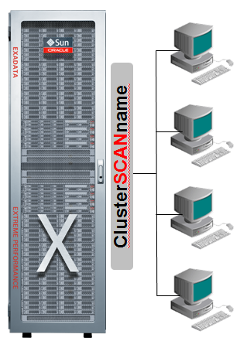
MAA for Compute Servers
Oracle Real Application Cluster
Accelerate instance recover
Tune FAST_START_MTTR_TARGET to meet your SLA’s
Configure client connections to take advantage of automatic node failover
Fast Application Notification (FAN)
Transparent Application Failover (TAF)

Slide 22
Use Oracle Resource Management
Reliable Service & Optimal Performance in Consolidated Environments
Use hugepages for optimal memory management
My Oracle Support Note 361323.1
Instance Caging - limit the amount of CPU used by an Oracle instance
Database Resource Manager - allocate CPU resources across multiple services that share the same database
I/O Resource Manager - allocate I/O bandwidth among databases
IORM is unique to Exadata storage

Slide 23
Prevent, Detect, and Repair Data Corruptions
My Oracle Support Note 1302539.1
DB_BLOCK_CHECKSUM=FULL
Detect physical corruption, auto-repair corruptions detected in memory
DB_BLOCK_CHECKING=MEDIUM | FULL
Detect logical corruptions, auto-repair corruptions detected in memory
DB_LOST_WRITE_PROTECT=TYPICAL
Detects silent corruption due to lost or mis-directed writes
Active Data Guard auto-block repair of corruptions detected on-disk
Identical settings on primary and standby databases
Notes:
Less than5% overhead observed for block checksum or lost_write protection.
Larger impact for Blocak checking, particularly at the primary.

Slide 24
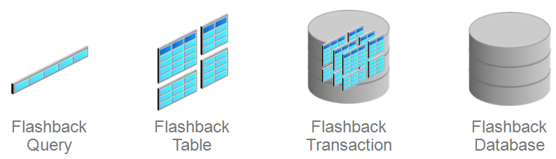
Fast Recovery from Corruption
Oracle Flashback Technologies
Flashback operates on changed data only
Correction time is reduced from hours to minutes
Correction time = error time + f(DB_SIZE)
Rebuild of standby = Minutes + (DB_SIZE x network bandwidth)
Notes:
MOS 565535.1

Slide 25
Fast Recovery from Corruptions
Oracle Flashback Technologies
Enable Flashback Database
Minimal impact to OLTP workloads
Minimal impact to DW loads if operational practices and recommended patches are in place (MOS 565535.1)
Use local extent managed tablespaces
Recreate objects instead of truncate tables prior direct load
Size fast recovery area minimum
redo rate X DB_FLASHBACK_RETENTION_TARGET
Notes:
The 2 main points are 1) minimum impact for OLTP and 2) load rate of 452 MB/sec or 1.5 TB/hour were still achieved with flashback enabled due to enormous IO bandwidth of exadata and configuration best practices. The note has all the details and practices.
When recreating objects, there is a penalty of dependent object invalidation and the need to recreate any existing indexes. However you will take advantage of the flashback block new optimization which will avoid creating flashback data during a direct load. Furthermore, if this is a big load, then PLSQL invalidation is small temporary pain compared to the flashback overhead throughout the load. Creating the indexes after the load will be more efficient and less overhead compared to having pre-existing indexes during the load too.

Slide 26


Backups
Two Aspects to Exadata Backup: Software and Destination
Backup Software
Recovery Manager (RMAN)
On-disk backups in the fast recovery area (FRA)
Backup once, incremental forever
Oracle Secure Backup (OSB)
Manages the location and life cycle of backups
Choice of backup destinations
Exadata storage
Non-Exadata disk storage: Oracle or third party products
Tape: Oracle or third party products

Slide 27
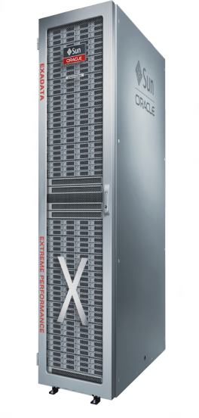
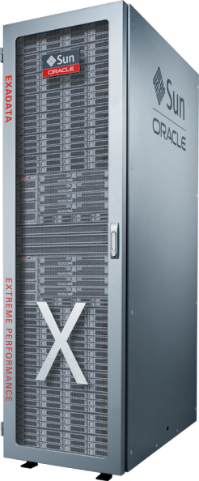

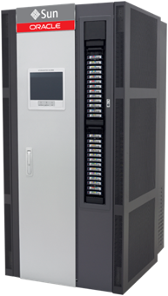

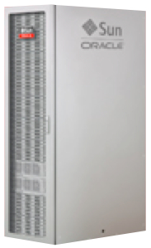
Exadata Backup Destination Options
Storage Expansion Rack
Fastest Backup and Restore
ILM Historical Archive
Second DATA2 Disk Group
Expansion of DATA
Oracle Secure Backup Admin Server
InfiniBand
Network
Ethernet
Oracle Secure Backup Media Servers
10GigE or InfiniBand
Network
Fiber Channel
SAN
Tape library
Offsite Backups
Vaulting
10GigE or InfiniBand
Network
ZFS Storage Appliance
Backups of database & non-database files
Snapshots
Clones

Slide 28
Disaster Protection
Oracle Active Data Guard – Oracle Aware Data Protection
Production Workload
Queries, read-only reporting offloaded
Data Guard
Continuous Redo
Shipment and Apply
Production Database
Active Standby Database
Data Guard Broker
Enterprise Manager Grid Control
Notes:
Data Guard – included feature of Oracle EE for Real-Time Data Protection and Availability
www.oracle.com/goto/dataguard

Slide 29
Data Guard Best Practices
Configure network for Data Guard transport
Set Oracle Net RECV_BUF_SIZE and SEND_BUF_SIZE and maximum TCP socket buffer sizes >= 10MB or 3 X BDP
Place standby redo log groups on fastest portion of disk
Tune Active Data Guard apply performance if necessary
Assess apply performance using standby statspack
Tune based on top wait events (coordinator / recovery slaves)
Monitor real-time query performance using Active Session History

Slide 30
Data Guard Best Practices
Hybrid columnar compression (HCC) conserves bandwidth
78% reduction in redo volume and network consumption
4% reduction in elapsed time required to complete load with HCC enabled
For all best practices, refer to:
Best Practices for Disaster Recovery for Exadata Database Machine
MegaBytes of data

Slide 31
Integrated, Automatic Client Failover
Use SRVCTL to configure Clusterware managed services
Data Guard Broker is required for complete automation
CRS starts/stops services appropriate for database role
FAN compliant clients are automatically notified
srvctl add service -d <db_unique_name> -s <service_name> [-l [PRIMARY][,PHYSICAL_STANDBY][,LOGICAL_STANDBY] [,SNAPSHOT_STANDBY]] [-y {AUTOMATIC | MANUAL}][-r <instance1,instance2…>]

Slide 32
Integrated, Automatic Client Failover
Oracle Net Alias – An Example
Connection should specify both primary and standby SCAN hostnames
SALES= (DESCRIPTION_LIST= (LOAD_BALANCE=off)(FAILOVER=on) (DESCRIPTION= (LOAD_BALANCE=on)(CONNECT_TIMEOUT=10)(RETRY_COUNT=3) (ADDRESS_LIST= (ADDRESS=(PROTOCOL=TCP)(HOST=Austin-scan)(PORT=1521))) (CONNECT_DATA=(SERVICE_NAME=OrderEntry))) (DESCRIPTION= (LOAD_BALANCE=on)(CONNECT_TIMEOUT=10)(RETRY_COUNT=3) (ADDRESS_LIST= (ADDRESS=(PROTOCOL=TCP)(HOST=Houston-scan)(PORT=1521))) (CONNECT_DATA=(SERVICE_NAME=OrderEntry))))

Slide 33
Oracle MAA Reference Configurations

Slide 34
Exadata MAA Configuration Options
Local Disaster Recovery with Zero Data Loss
SYNC
Primary
Local Standby
HA Engineered into the Exadata system
Second Exadata system deployed for local DR (within 200 miles)
Synchronous redo transport, Data Guard Maximum Availability
Active Data Guard: offload read-only reporting

Slide 35
Exadata MAA Configuration Options
Remote Disaster Recovery with Maximum Performance
Asynchronous Transport
Primary
Remote Standby
HA Engineered into the Exadata system
Second Exadata system deployed for remote DR
Asynchronous redo transport, Data Guard Maximum Performance
Active Data Guard: offload read-only reporting

Slide 36
Exadata MAA Configuration Options
Multi-Standby: Local HA Failover plus Geographic Protection
Local Standby
SYNC
Asynchronous
Primary
Remote Standby
Dual standby configuration
Local standby is primary failover target with zero data loss
Remote standby is failover of last resort
Either is used to offload read-only workload, backups, rolling upgrades, test

Slide 37

Bank Of America

Slide 38
Exadata and Maximum Availability Architecture
for Client Reporting Center (CRC) Database
Rahul Pednekar
DBA- Bank Of America

Slide 39






CRC Architecture – Before Exadata
Batch Files
ETL
Oracle 10g
Real-time
Messages
Informatica
.NET
consumers
Equities Data
IDS
RDW
What is CRC?
Centralized Data Warehouse for reference data, financial transactions, positions, and balances data for institutional investors
Periodic Position calculation
Millions of unique trades/non-trades are processed daily
6,000 reports generated daily, expected to grow by 10X in next few years
Over 150 inbound feeds/message flows, over 300 workflows (Informatica)
Database Size: Over 20 TB
Business & IT Challenges
Complexity of the stack
Fight for System Resources
Regular miss of SLAs
Unproductive use of technical resources for job scheduling, database backup, resource management, etc.
20+ hours of backup /recovery of 2 large 10g DBs.
DR site could not be used for backup due SRDF method of replication
Corruption could not be avoided due to storage replication
Cognos
Reports

Slide 40

CRC Architecture – with Exadata
Batch Files
ETL
Landing
Staging
IDS
Exadata X2-2
Real-time
Messages
Informatica
.NET
consumers
ETL
Equities Data
Business Benefits
NO SLA misses since going live in May 2011
New applications that could not be deployed in pre-Exadata environment due to capacity and performance bottlenecks are deployed now
Performance Improvement - ETL and Batch jobs are running up to 7X faster
Generating over 10,000 reports daily
Maximum Availability - No Single Point of Failure
Disaster Recovery (DR) Database can be opened anytime if needed
Cognos
Reports

Slide 41
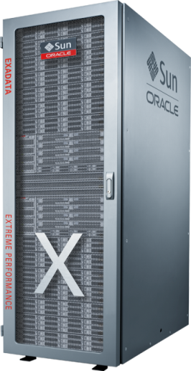
CRC Exadata – Rapid Migration Steps & Techniques Used
Pre-Exadata (10g Prod)
Pre-Exadata (10g DR)
EMC SRDF
IDS
RDW
2. Break Mirror
IDS
RDW
1. Stop Databases
3. 11g DB pre-created. Data move using TTS
4. Create Standby at primary DC using Compressed Backup from DR site
Standby Primary
5. Reverse Roles
Primary Standby
Primary DC
DR DC
Two large 10g databases, total 20TB, were consolidated and migrated to Oracle 11gR2 in Exadata within 15 hours. DR solution was built by using Oracle Data Guard

Slide 42
CRC Exadata – Migration Techniques Used
Broke storage mirror between Production and DR
DR file systems were mounted on Oracle Exadata machine and multiple NIC cards were used .
Use of 4 NIC cards to pull data into Oracle Exadata significantly improved data transfer rate during migration. Difference made by 4 NICs v/s 1 NIC in terms of throughput and elapsed time to migrate 20 Terabytes reduced from 33 hrs to 13 hrs.
RMAN convert and TTS methodology used in migration. Multiple RMAN convert scripts launched in parallel for faster data copy from 10g to 11g.
Physical Standby with Maximum Performance Mode Created and roles were switched between Primary and DR using “SWITCHOVER” command.

Slide 43
IT Benefits with Exadata
Minor changes to applications as it was already running on Oracle and Linux
Database growing at 500GB per month vs. 250GB before oracle Exadata
Full Backup takes <6 hours for 30 TB vs. 21 hours for 20TB in the old system
Stats gathering now takes 6 hours vs. 48 hours in the old system
Development team can concentrate on new development activities
Unlike Storage replication (SRDF), Data Guard is protecting data from corruptions
Effective Use of Standby resources for backup and reporting (future)
Faster switchover/failover to standby database (<10 minutes)

Slide 44
Maximum Availability Architecture
DW
X2-2
X2-2
X2-2
Data Guard
DGMGRL> show configuration;
Configuration - gmfcdwp_conf
Protection Mode: MaxPerformance
Databases:
gmfcdwp_tel - Primary database
gmfcdwp_lvt - Physical standby database
Fast-Start Failover: DISABLED
Configuration Status:
SUCCESS
Primary
Standby
Dev/QA
NY Data Center
PA Data Center

Slide 45
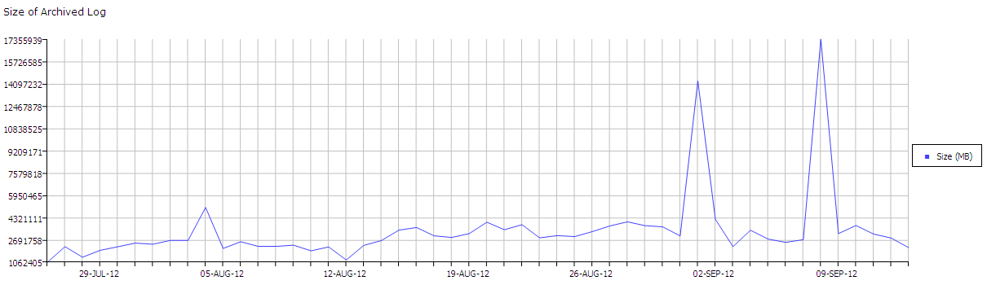
Daily Redo GENERATION Rate
Daily ARCH generation at CRC ranges (8 instances) between 2 to 4 Terabytes/day
Occasional spikes seen that goes beyond 10+ Terabytes for certain ad-hoc maintenances done in DB such as MERGE partitions, SPLIT partitions of big partition TABLES
APPLY & TRANSPORT LAG is generally within seconds vs SLA of 15 minutes
45

Slide 46
Data Guard –Broker ConFIGURATION
DGMGRL> show database 'gmfcdwp_lvt';
Database - gmfcdwp_lvt
Role: PHYSICAL STANDBY
Intended State: APPLY-ON
Transport Lag: 0 seconds
Apply Lag: 1 second
Real Time Query: OFF
Instance(s):
gmfcdwp1
gmfcdwp2
gmfcdwp3
gmfcdwp4
gmfcdwp5
gmfcdwp6
gmfcdwp7 (apply instance)
gmfcdwp8
Database Status:
SUCCESS
46

Slide 47
CRC Exadata – Best Practices and Next Steps
Benefits of Data Guard in Current Implementations.
Rapid provisioning of Standby with Compressed backup onto FRA and copying the same to Standby using ASMCP
Use Data Guard Broker and Grid Control for easier mgmt, switchover, failover, etc.
Offload backup to DR Site and Backup Standby database using RMAN to FRA then copy the backup files to tape using RMAN via backup recovery area
Weekly FULL, incremental daily backup with compressed & block change tracking to improve the performance of backup
RMAN compressed backup with 64 Channels on Full X2-2 gave us best performance – Under 6 hrs for 30TB
Standby Database backups used for refreshing downstream application databases
Next Steps to expand benefits of Data Guard at BAC.
Use of 10gE network between Standby and QA/Dev machines for faster refresh
Implement ACTIVE data guard for real-time reporting .
Use Standby database as Snapshot Standby for testing

Slide 48
Summary
Exadata is delivering both IT and Business Benefits
No SLA misses
Excellent Performance
Ability to support new business initiatives
Maximum Availability Architecture with Data Guard is delivering:
Maximum Availability
Effective Use of Standby resources for backup and reporting (future)
Protection from data corruptions
Faster refresh of downstream databases
Exadata is enabling IT to partner with and focus on Business

Slide 49

Conclusion & Resources

Slide 50
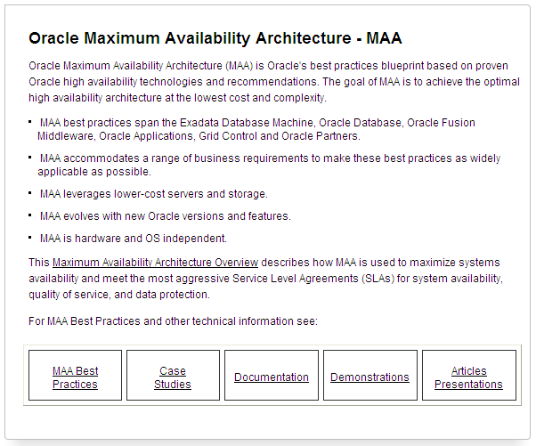
Maximum Availability Architecture
Experience from Thousands of Deployments, Validated in Oracle Labs
HA best practices for:
Exadata Database Machine
Oracle Database
Oracle Fusion Middleware
Oracle Applications
Cloud Control
Partner solutions
Ref. http://www.oracle.com/goto/maa

Slide 51
Building Blocks of MAA
Architecture and Best Practices
MAA
Architecture
This Presentation
Configuration Best Practices
CON8392: Operational Best Practices For Oracle Exadata
Wednesday, 10:15am, Room 102 Moscone South
Operational Best Practices
Notes:
Here’s the 3 pillars to reach MAA. With Exadata, each pillar has been optimized for MAA and simpler to deploy.

Slide 52
Resources
OTN HA Portal: http://www.oracle.com/goto/availability
Maximum Availability Architecture (MAA): http://www.oracle.com/goto/maa
Exadata on OTN: http://www.oracle.com/technetwork/database/exadata/index.html

Slide 53
Key HA Sessions and Demos by Oracle Development
Monday, 1 October – Moscone South
12:30p Oracle Data Guard Zero-Data-Loss Protection at Any Distance, 300
12:30p Future of Exadata: OLTP, Warehousing, and Consolidation, 104
1:45p Automating ILM with the Latest Database Technology, 300
1:45p Extracting Data in Oracle GoldenGate Integrated Capture Mode, 102
3:15p Maximize Availability with the Latest Database Technology, 303
3:15p Maximize Enterprise Availability with the Latest DB Technology, 303
4:45p Mission-Critical Oracle Exadata OLTP Deployment at PayPal, 300
4:45p Temporal Database Capabilities with the Latest DB Technology, 300
Tuesday, 2 October – Moscone South
10:15a Database Tables to Storage Bits: Data Protection Best Practices, 300
10:15a GoldenGate & Data Guard: Working Together Seamlessly, 305
11:45a Active Data Guard Zero-Downtime Database Maintenance, 300
11:45a Using Automatic Storage Mgmt with the Latest DB Technology, 301
1:15p The Four Ts of RMAN: Tips, Tuning, Troubleshooting, and … ?, 102
5:00p Maximum Availability Architecture Best Practices for Exadata, 303
Wednesday, 3 October – Moscone South
10:15a Operational Best Practices for Oracle Exadata, 102
10:15a Maximize Availability by Minimizing Disruption for End Users
and Application, 301
11:45a What’s New in the Latest Generation of Oracle RAC, 301
11:45a Best Practices for HA w/ GoldenGate on Oracle Exadata, 102
1:15p Oracle Secure Backup: Integration Best Practices with
Engineered Systems, 300
1:15p Application MAA Best Practices on Oracle Private Clouds, 200
5:00p Tuning &Troubleshooting Oracle GoldenGate on Oracle, 102
Thursday, 4 October – Moscone South
11:15a Integrate Your Globally Distributed Databases for Key
Cloud Computing Benefits, 300
12:45p Backup and Recovery of Oracle Exadata: Experiences
and Best Practices, 300
Demos – Mon 10:00a-6:00p - Tue 9:45a-6:00p - Wed 9:45a-4:00p
Oracle Maximum Availability Architecture, S-011
GoldenGate 11gR2: Real-Time, Transactional DB Replication, S-027
Oracle Database 12c: Global Data Services, S-010
Oracle Database 12c Application Continuity - S-009
Oracle Secure Backup, S-014
Oracle Active Data Guard, S-007
Oracle Recovery Manager and Oracle Flashback Technologies, S-019
Oracle Real Application Clusters and Oracle RAC One Node - S-008
Oracle Database 12c Xstream, Streams, Advanced Queing, S-018
After OpenWorld, visit oracle.com/goto/availability

Slide 54

Graphic Section Divider

Slide 57
声明：
所有的版权属于原有公司，文件均来自公开渠道
此文件仅供学习使用，任何人不得进行以此为商业目的的行为
如有疑问，请立即删除
学习世界五百强和咨询公司PPT课程请访问如下网站搜索：“司马懿”
百度传课：司马懿PPT学校
https://www.chuanke.com
网易学堂：司马懿PPT学校
https://study.163.com
知乎： 司马懿PPT学校
https://www.zhiu.com

